Slide 1
PILLBOT: VOICE CONTROLLED ROBOT FOR DELIVERING MEDICINES
Presented by:
Jayaashree P - 2019105541
Shwetha A - 2019105576
Harini V - 2019105013
Lavanya S - 2019105024
Project guide:
Dr. Jeyalakshmi V
Project coordinators:
Mrs. P. Steffi Snow
Dr. O. Uma Maheshwari
Department of ECE
College of Engineering,Guindy

Slide 2
WORK DONE FOR REVIEW 1:
BUILT ROBOTIC SYSTEM AND CHECKED THE WORKING CONDITION THROUGH VOICE CONTROLLED MECHANISM
BUILT APPLICATION FOR VOICE CONTROL USING MIT APP INVENTOR.
WE USED L293D MOTOR DRIVER SHIELD, MOUNTED OVER ARDUINO TO BUILT THE ROBOTIC MODEL SUCH THAT WE WERE ABLE TO CONTROL THE ROBOT.
VOICE COMMANDS- FORWARD, REVERSE, LEFT AND RIGHT WERE ISSUED VIA APP IN MOBILE.
COMMANDS WERE DETECTED SUCCESSFULLY AND PASSED ONTO THE BOT BY THE ARDUINO WHICH IN TURN NAVIGATED THE BOT.

Slide 3
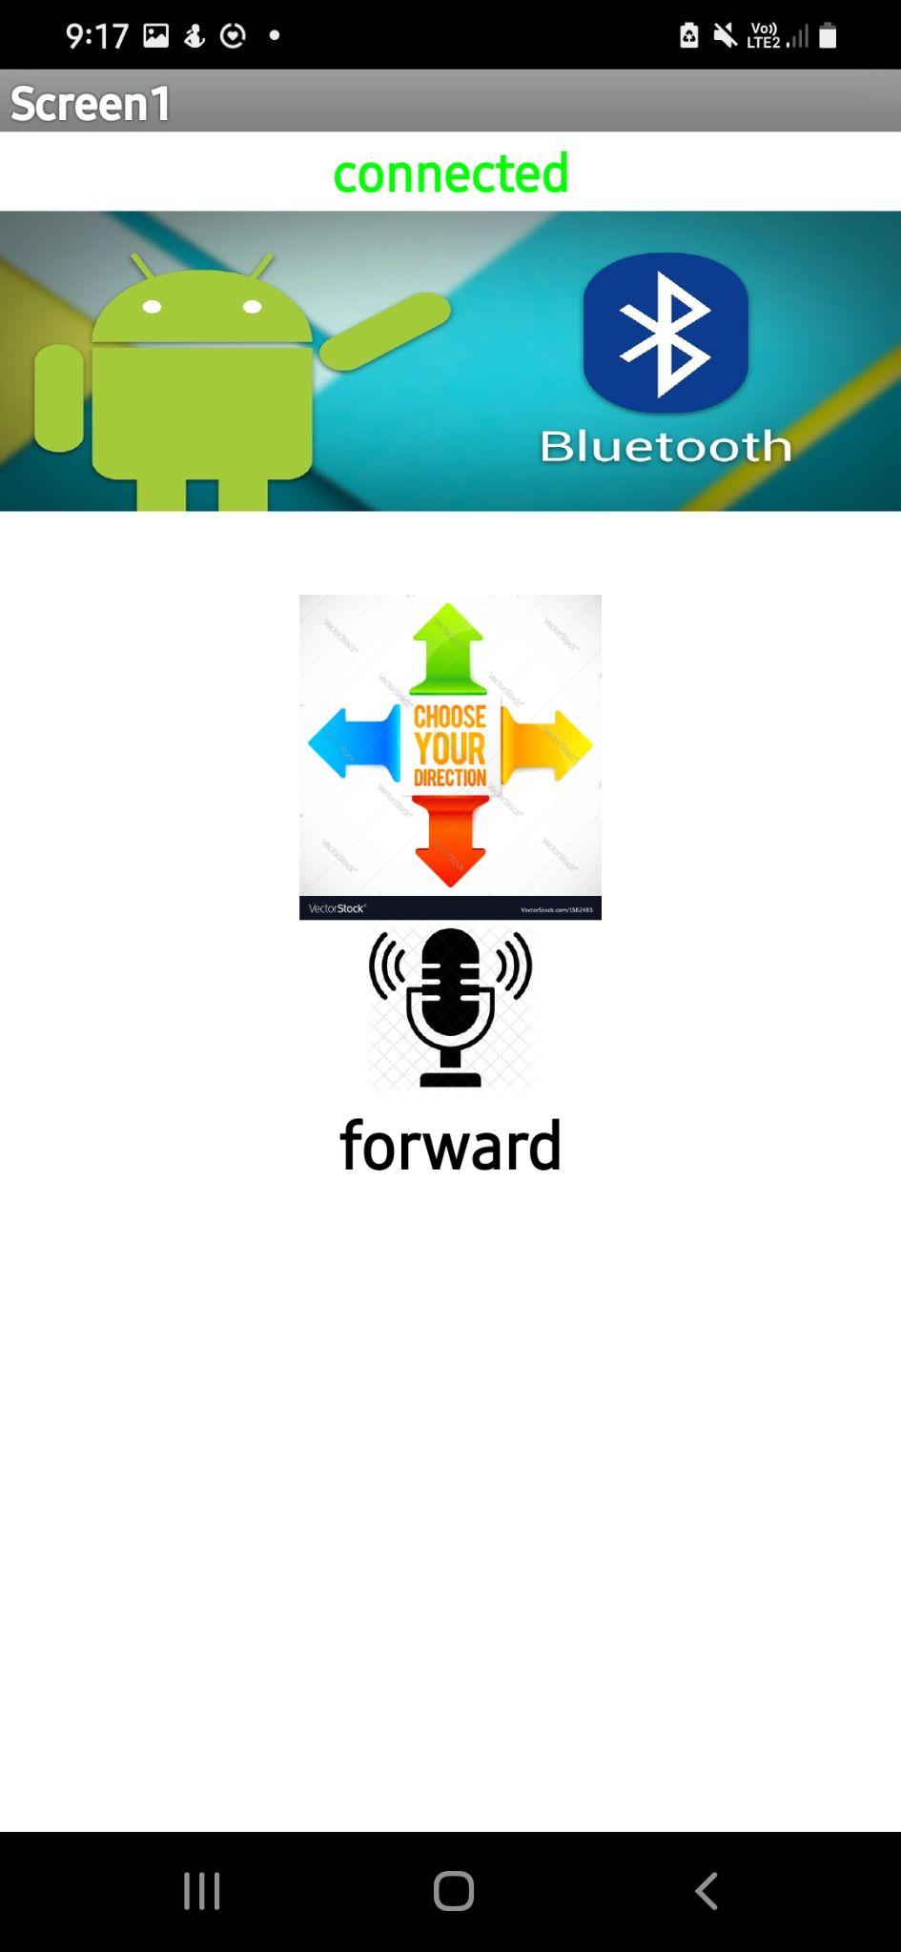
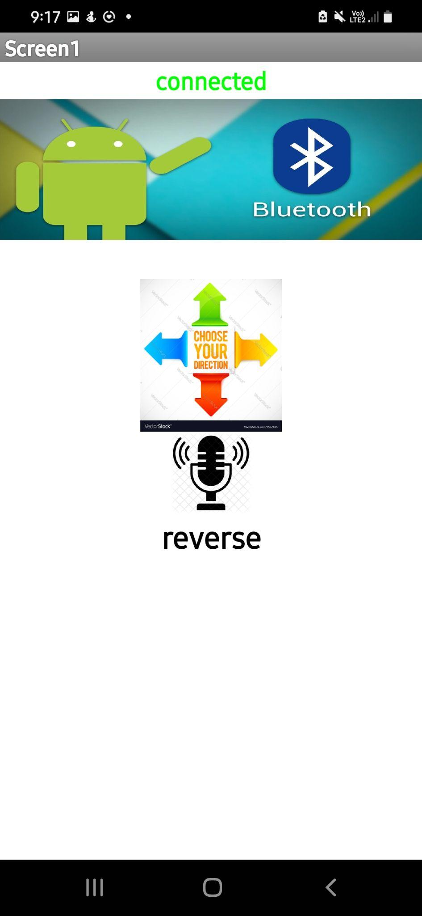
Android Application Screen

Slide 4
COMPONENTS
HARDWARE
SOFTWARE
Arduino ATmega1280
HC-05 Bluetooth module
IR Sensor
L293D Motor driver shield
Chassis kit
9V Battery
MIT App Inventor
Arduino IDE
EasyEDA

Slide 5
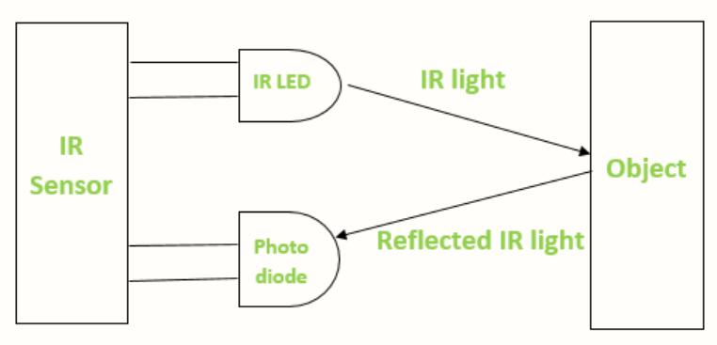
IR SENSOR
IR sensor is an electronic device, that emits the light in order to sense some object of the surroundings. It can measure the heat of an object as well as detects the motion.
The emitter is simply an IR LED and the detector is simply an IR photodiode . Photodiode is sensitive to IR light of the same wavelength which is emitted by the IR LED. When IR light falls on the photodiode, the resistances and the output voltages will change in proportion to the magnitude of the IR light received.
When the IR transmitter emits radiation, it reaches the object and some of the radiation reflects back to the IR receiver. Based on the intensity of the reception by the IR receiver, the output of the sensor defines.This is the underlying working principle of the IR sensor.

Slide 6
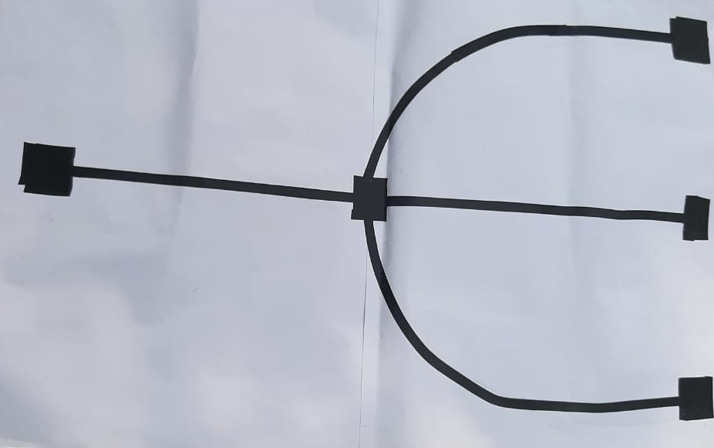
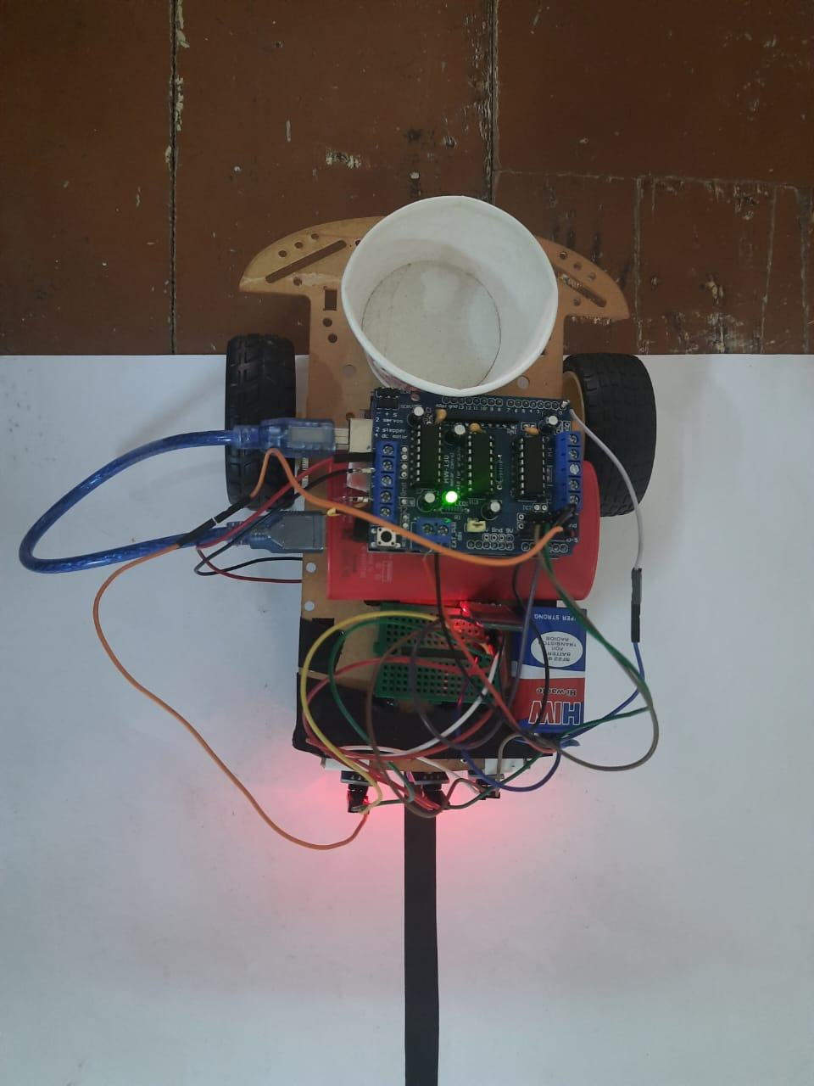
PILL BOT
ACCORDING TO THE COMMAND GIVEN IN ARDUINO THE ROBOT HAS TO NAVIGATE TO THE POSITION. IN OUR CASE WE HAVE GIVEN COMMAND FOR 3 ROOMS WHERE NECESSARY MEDICINE SUPPLY HAS TO BE DELIVERED TO THE PATIENT IN THAT PARTICULAR ROOM.
MAP DESIGN

Slide 7


Slide 8
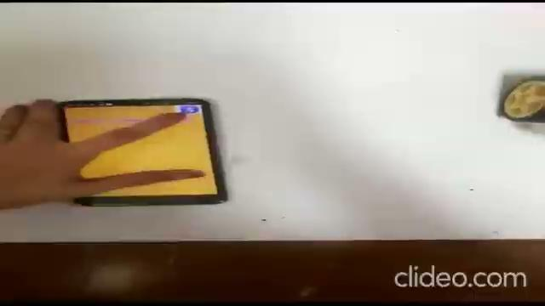
BOT MOVEMENT ACCORDING TO INPUT COMMANDS

Slide 9
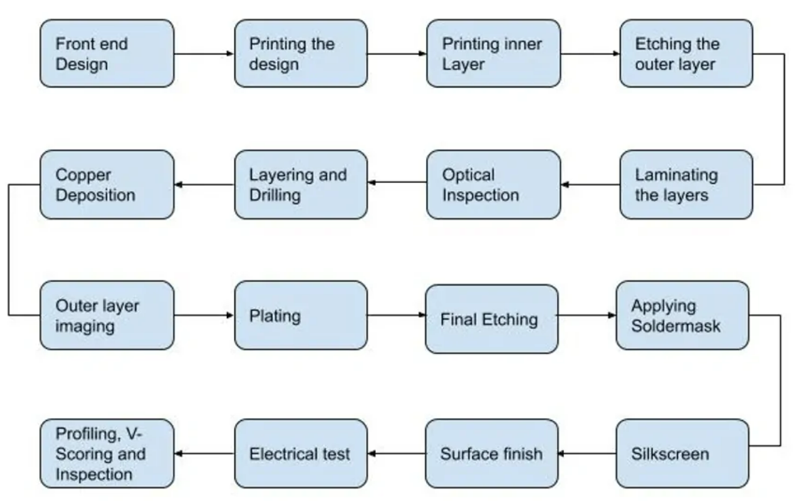
Various Steps in PCB Design and Manufacturing

Slide 10
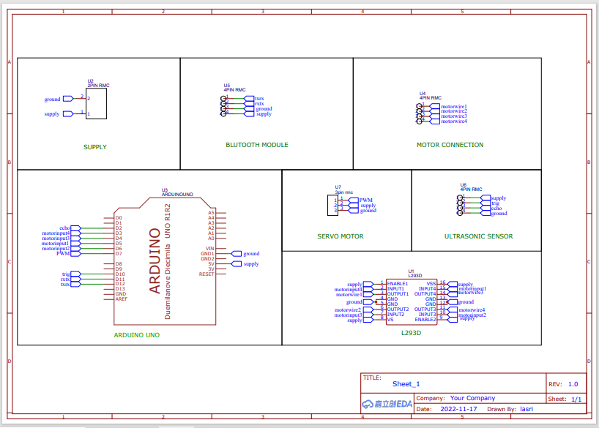
PCB DESIGN SCHEMATIC (using EasyEDA)

Slide 11
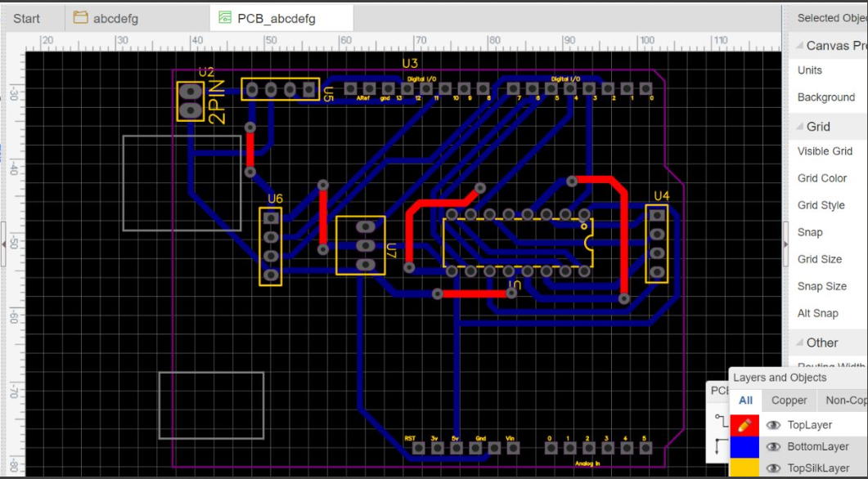

Slide 12
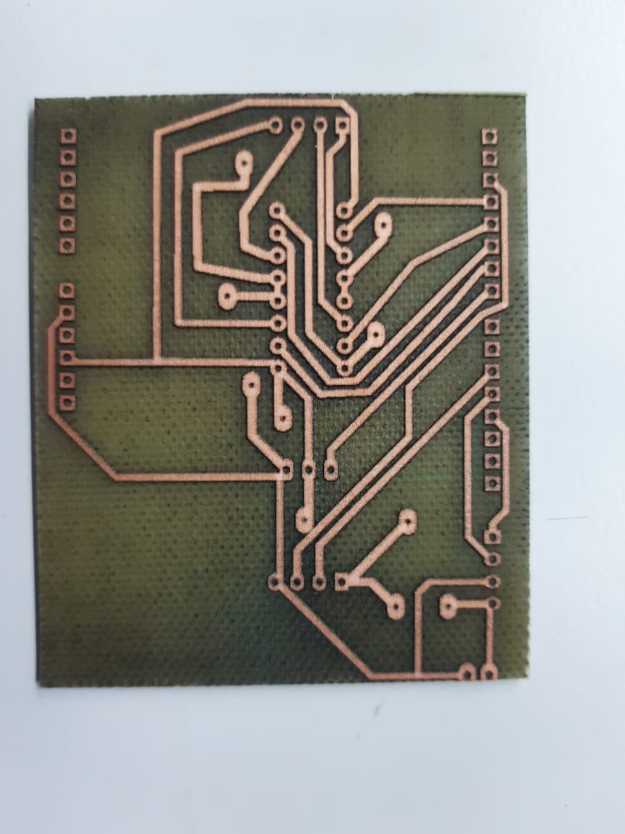
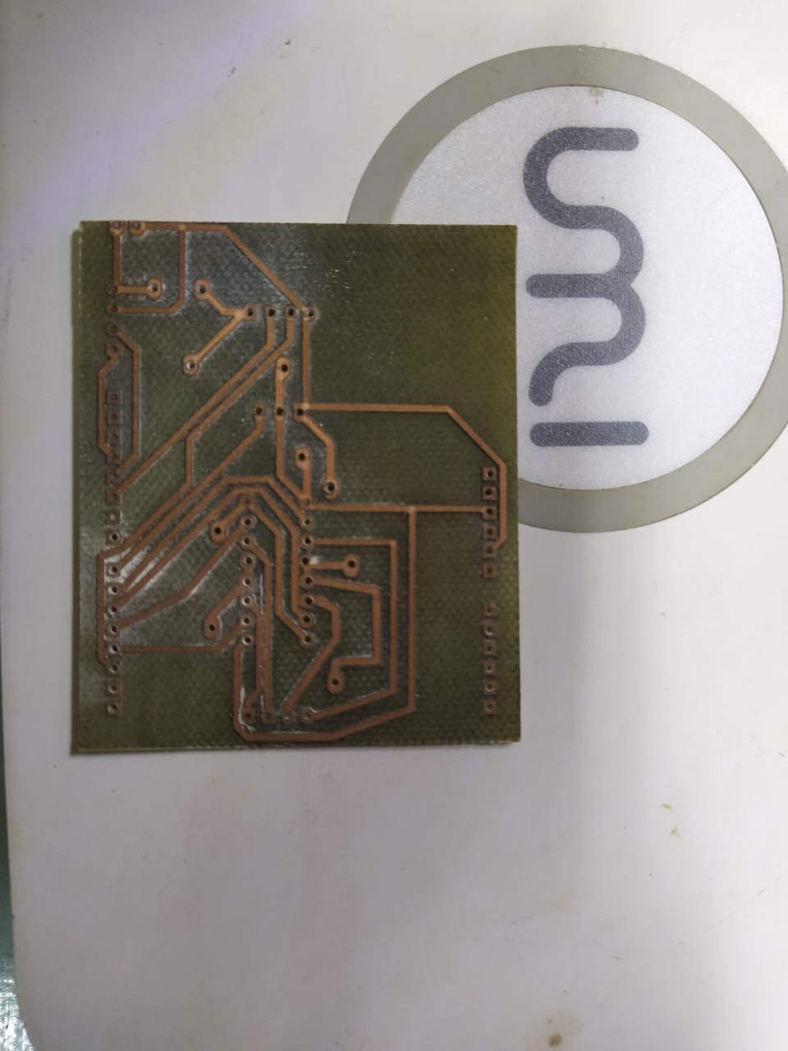
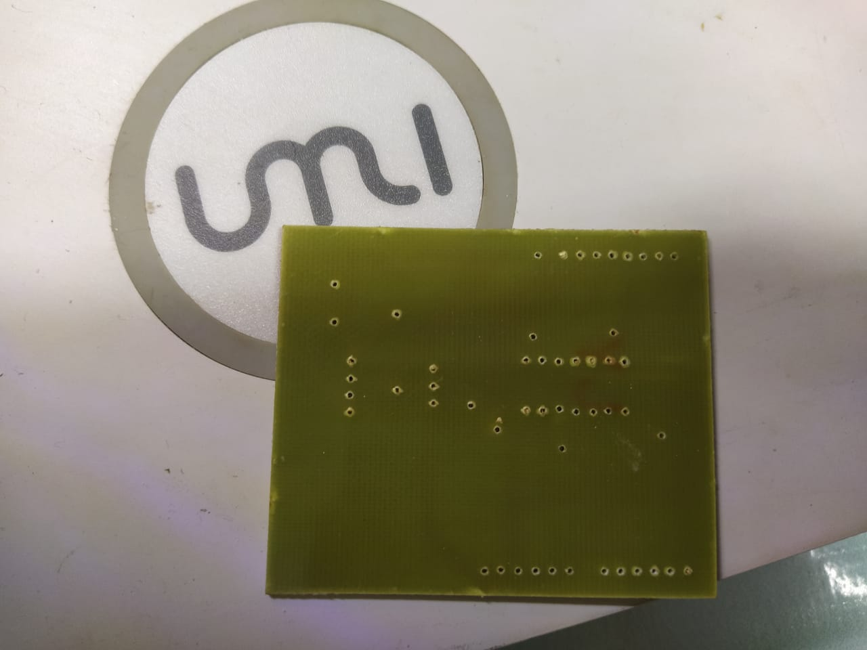
PCB LASER ETCHING AND DRILLING

Slide 13
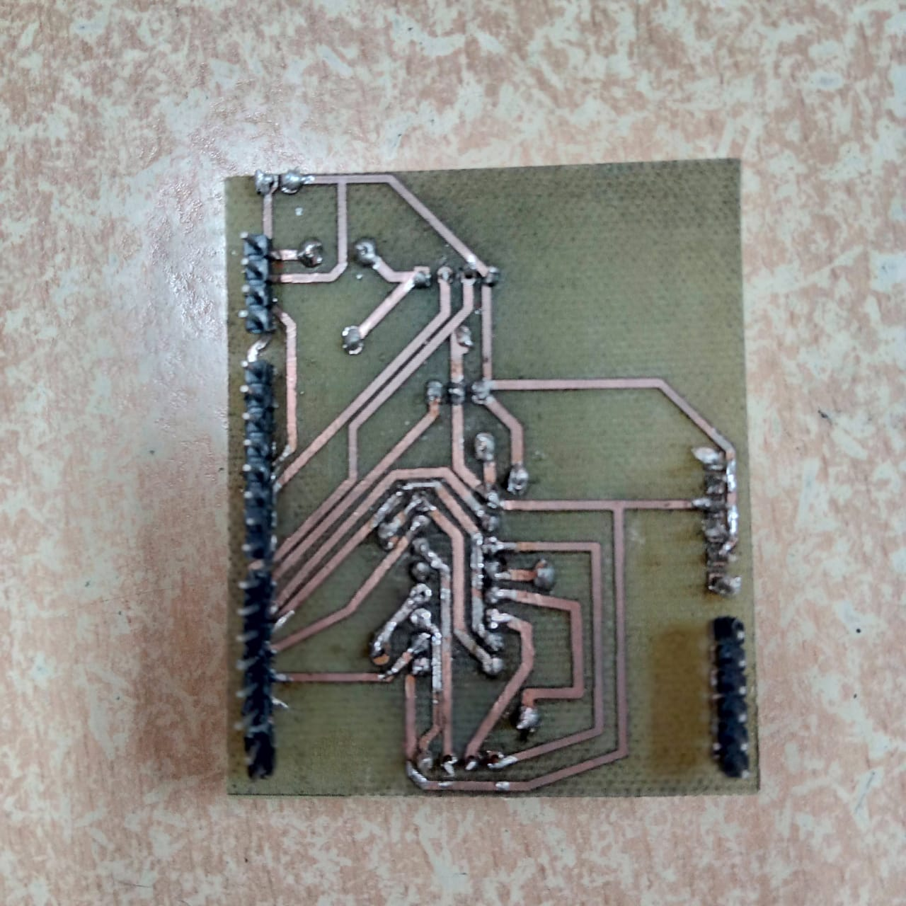
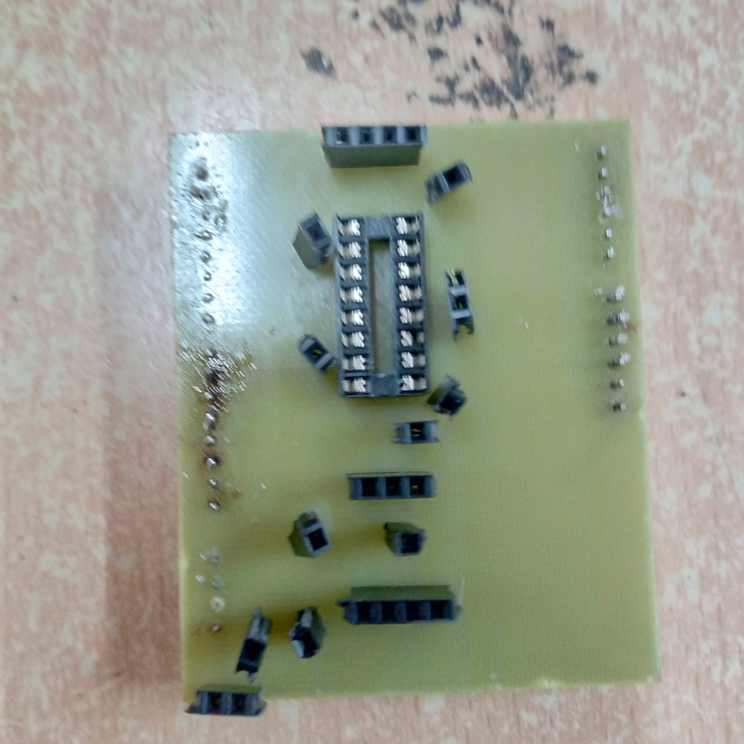
FINAL PCB BOARD

Slide 14
RESULT
Through our design and implementation of our proposed system we are able to achieve the following as results:
Pillbot is designed and controlled through voice commands given by the user who is operating the project through the mobile app created using MIT app Inventor.
The bot was able to navigate to the specified rooms carrying and delivering the pills.
CONCLUSION
Thus, we have designed a robot prototype that delivers medicines to quarantined rooms using Arduino Uno and IR sensors. It receives the commands given to the App through Bluetooth module.

Slide 15
REFERENCES
Aditya Chaudhry, Manas Batra, Prakhar Gupta, Sahil Lamba, Suyash Gupta ‘ARDUINO BASED VOICE CONTROLLED ROBOT’ in 2019 International Conference on Computing, Communication, and Intelligent Systems (ICCCIS)
PILLBOT: Non-Contact Medicine Dispensing System for Patients in Quarantine: Ms. Nanditha Krishna, Ms. R Navya Sree, Ms. Rajeshwari Sajith, Mr. S Kosal Ramji, Ms. Sheetal Ramesh in 2021 6th International Conference on Recent Trends on Electronics, Information, Communication & Technology (RTEICT), August 27th & 28th 2021

